Slide 1
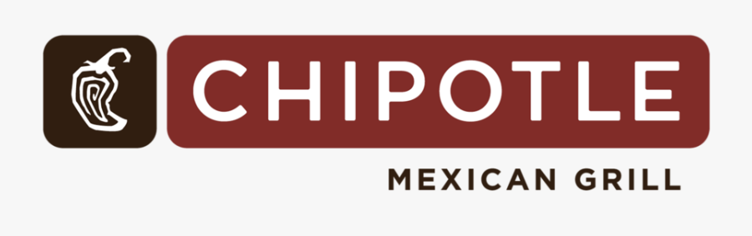
Melissa, Arthur, tiffany, Alvin, Mallory
Notes:
Arthur
Hello and welcome potential franchise owners and guests! This evening features our signature presentation: Take Charge of Your Future: Own a Chipotle! hosted by our Chipotle Mid-Atlantic & Gulf Bay Sales and Development Team. We are excited to have you with us this evening and congratulations on taking the first step towards a valuable investment of your time in your future!

Slide 2
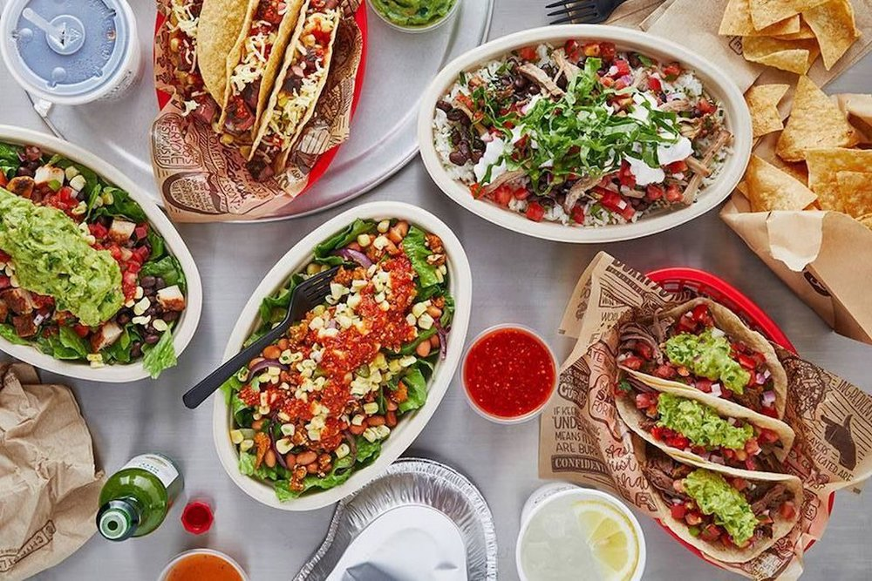
Agenda
Overview: Chipotle: Cultivating a Better World
Current Chipotle Presence
Chipotle location data
Fast food restaurant data
Chipotle Financial Performance
Chipotle Stock Data
Call to Action
Notes:
Arthur
In this presentation, we'll discuss why now is a good time to invest in your future and become a Chipotle franchise owner. We’ll provide an overview of the company’s values and beliefs, explore the geographic distribution of Chipotle
restaurants locations in the United States and discuss the historical financial performance of the Chipotle chain.
We’ll then open the floor for questions and further discussion.

Slide 3
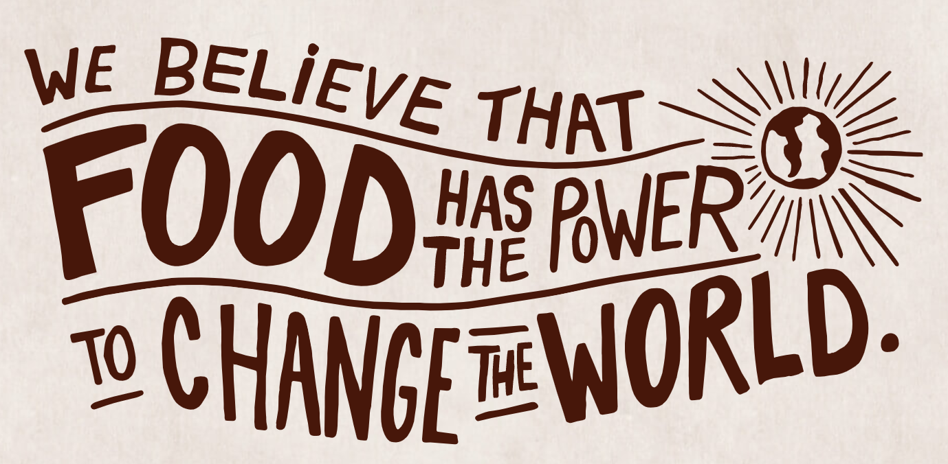
Notes:
Mallory Kuba
Here at Chipotle HQ, we believe that food has the power to change the world.
In fact, Chipotle was born of the radical belief that there is a connection between how food is raised and prepared, and how it tastes. Real is better. Better for You, Better for People, Better for Our Planet. It may be the hard way to do things, but it’s the right way.

Slide 4
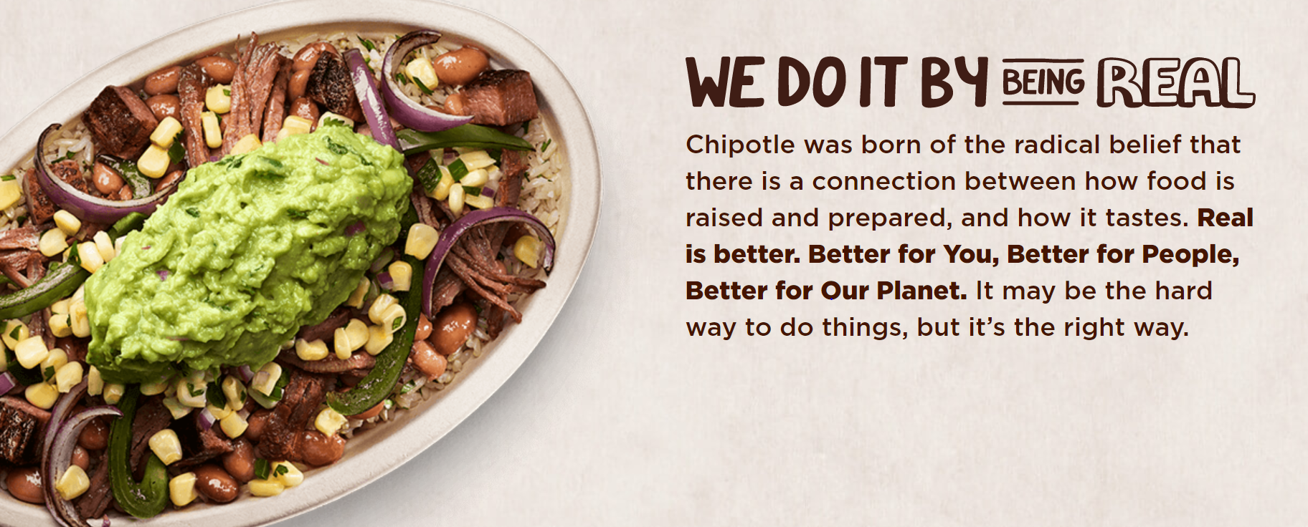
Notes:
Mallory
We do this at Chipotle by committing to:
No Artificial flavors, colors, or preservatives
No Microwaves, freezers or can openers.
No added hormones.
Only using 53 ingredients that you can pronounce (And the only ingredient that is hard to pronounce at Chipotle is “Chipotle”)
In addition Chipotle is one of the first national restaurant brands to commit to goals on local and organic produce & the first national restaurant brand to commit to using only responsibly raised meat with some of the highest animal welfare standards.
Taking care of our employees/treating our people right: Supporting people who live our values with real culinary training, career opportunities and great benefits.

Slide 5
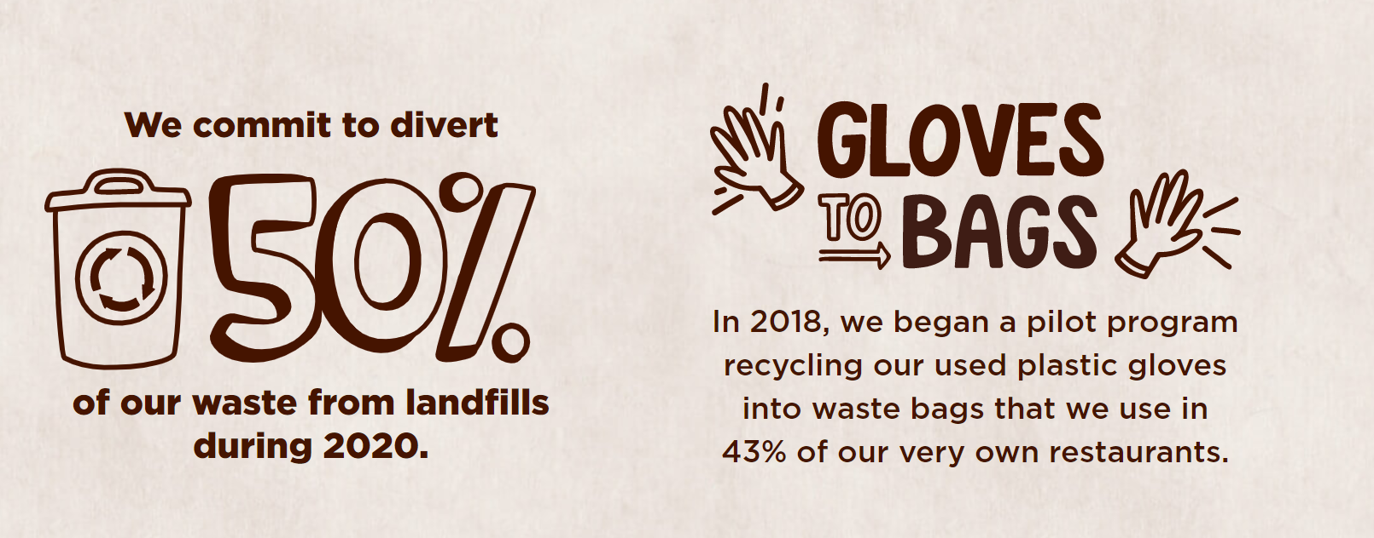
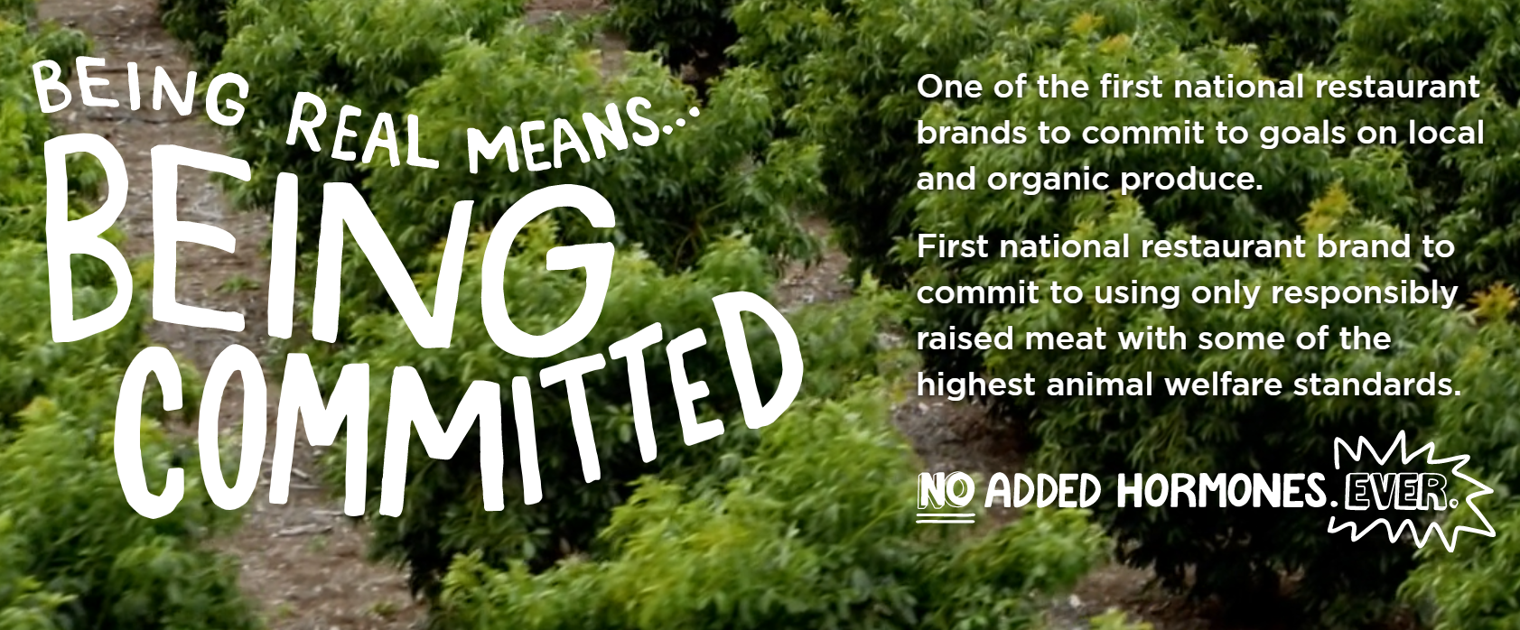
Notes:
Mallory
We would also like to touch on as well that our organization has a huge focus on sustainability and monitoring our impact to the planet. We currently commit to diverting 50% of our waste from landfills during 2020. In 2018 we also began a pilot program recycling our used plastic gloves into waste bags that we use in 43% of our very own restaurants.

Slide 6
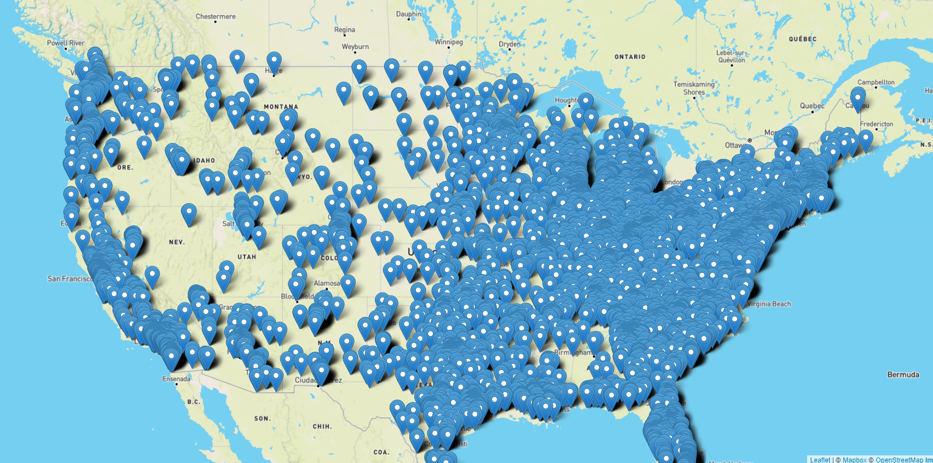
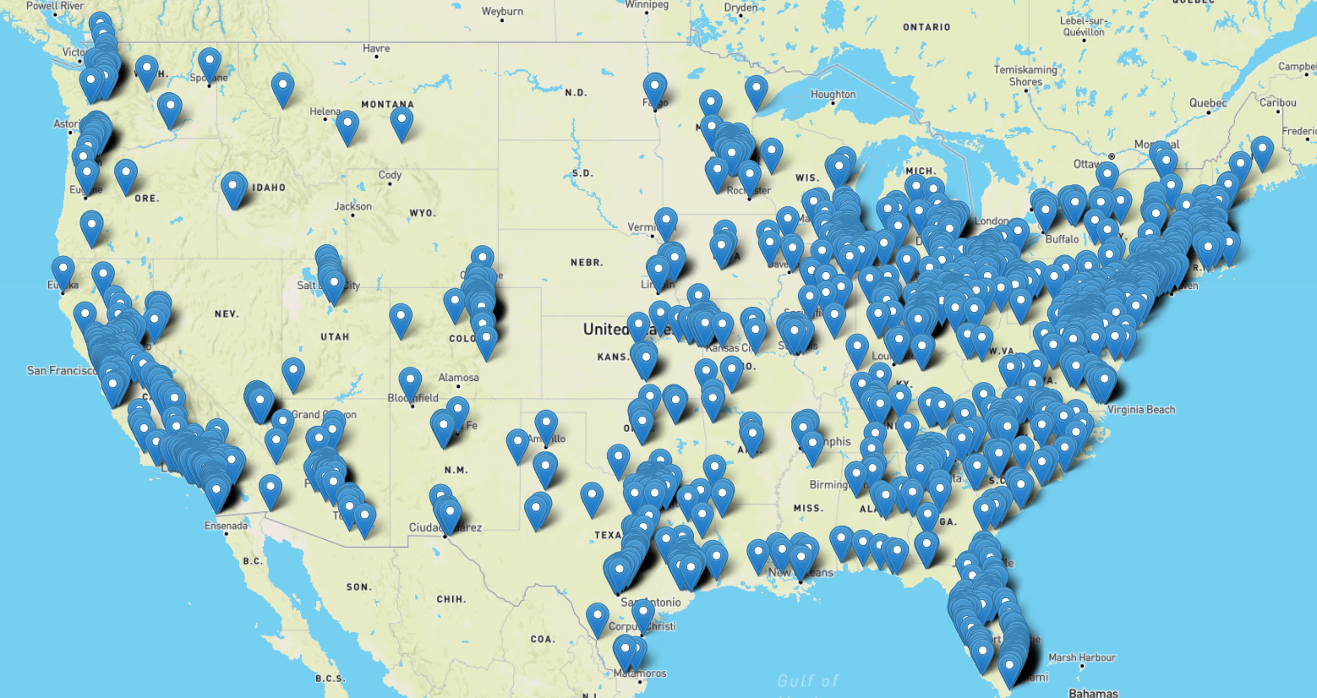
Chipotle Presence
Fast food restaurants - us
Chipotle locations - us
Notes:
Mallory
Now that you have some more insight on our company and what we stand for, we are going to provide you with some more information on our industry presence and our Company presence in the United States.
The overarching industry we classify Chipotle in is Fast Food Restaurants (noting that we also subset into the fast-casual dining as well). In the US, there
are 204,529 Fast Food Restaurants businesses as of 2021. As you can see from this map on the left, fast food restaurants have a huge presence in in the United States. Not only this, but this is a space that has been growing over the years (with an increase of 1.8% from 2020).
With the increasing demand for fresh, tasty, and appealing food at affordable cost, the demand for quick service restaurants has been increasing. Moreover, retaining the healthy and natural ingredients along with maintaining the taste also boosts the market growth. And this is Chiptole’s niche and specialty!
The map on the right-hand side of this data displays Chipotle’s current presence across the United States and the opportunities for all of you potential franchise owners! There are a total of 2,751 Chipotle locations in United States as of March 09, 2021. The state with the most number of Chipotle locations in the US is California with 429 locations, which is 15% of all Chipotle locations in America. Our data is displayed on this map is from seven months ago in August 2021. As you can see, we have so much opportunity for expansion and are excited to continue to share our mission across the US!

Slide 7
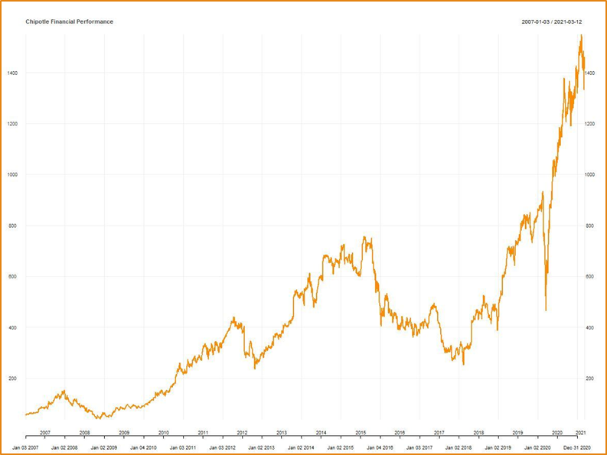
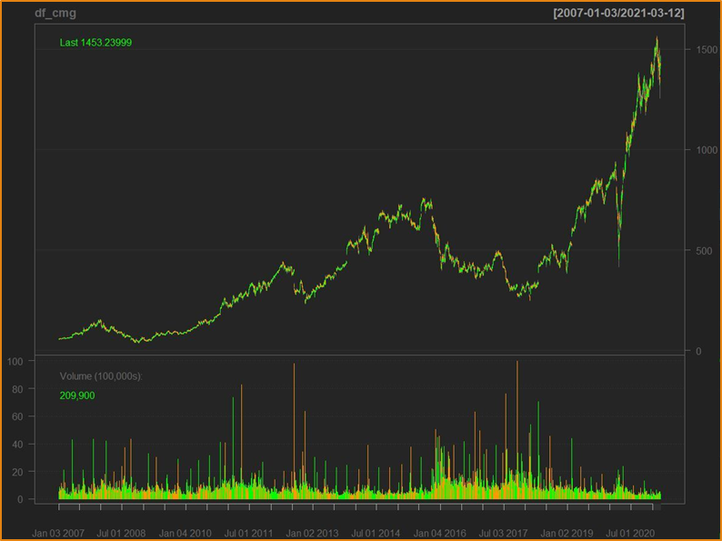
Chipotle Financial Performance
Notes:
Tif
· Despite impact of COVID-19 the total revenue for 2020 was $6.0 billion, an increase of 7.1% from 2019. The increase in total revenue was driven by a 1.8% increase in comparable restaurant sales and new restaurant openings. · In 2020 we opened 161 new restaurants during the year. · Digital sales grew 174.1% year over year to $2.8 billion and represented 46.2% of sales. About half of the digital sales were via delivery, benefiting from our expanded partnerships. · You heard it right. We are growing and we are bringing are partnerships with us. · Chipotle is committed to making its food more accessible to everyone while continuing to be a brand with a demonstrated purpose as it leads the way in digital, technology and sustainable business practices. · As Investor we know the bottom line is extremely import to you. As you can see it one of the many important things to us. Year over Year we have crush the year before.

Slide 8
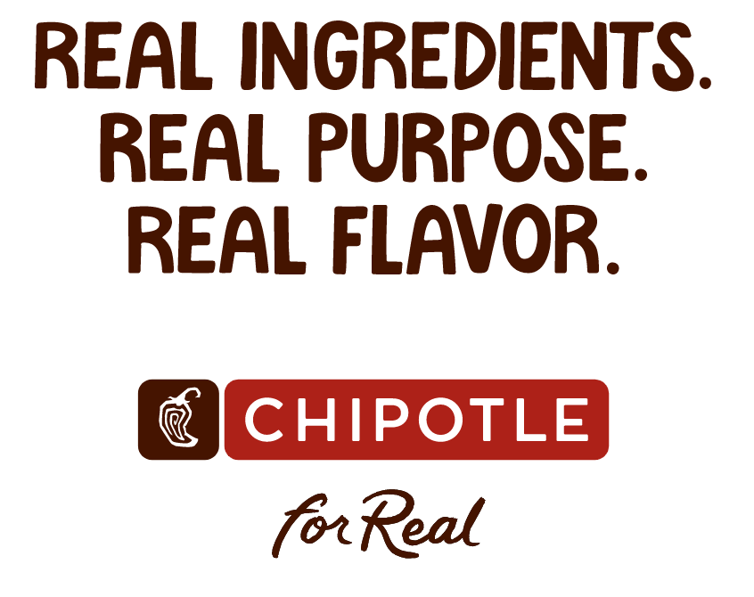
Notes:
Mel
CONCLUSION SLIDE
“Real Ingredients. Real Purpose. Real Flavor. In today’s presentation you heard from us about our company’s values and beliefs, learned about our geographical footprint of Chipotle restaurants locations in the United States and learned about the historical financial performance of the Chipotle chain. So I leave you with one last question: What’s stopping you? Take Charge of Your Future and own a Chipotle today!”

Slide 9

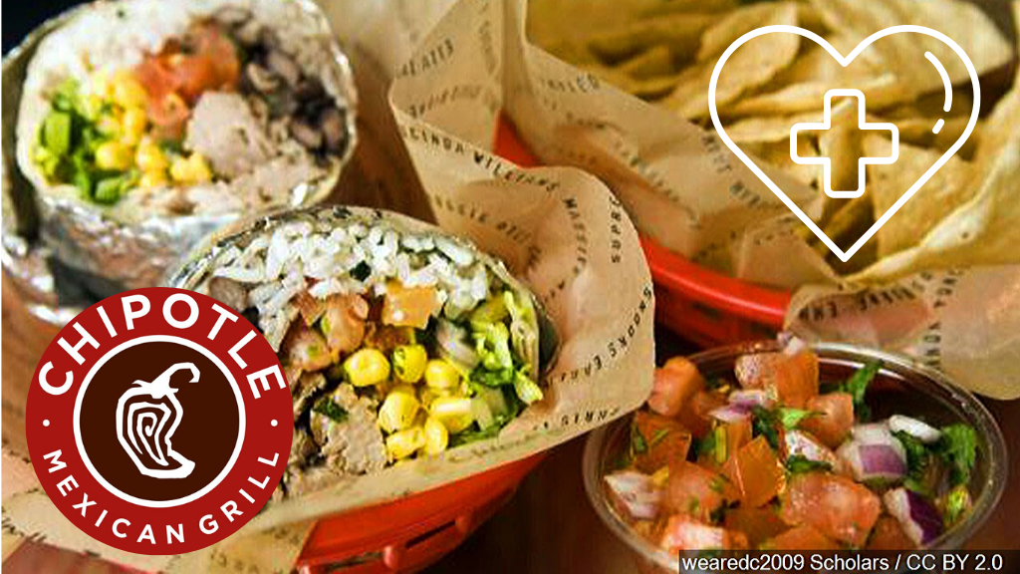
Notes:
Everyone

